Slide 1
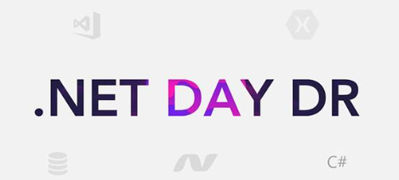
TDD en C#
Empezar con unit testing
Julissa mateo abad/ Gerente ti and ecm Bunker, lead mujeresticsrd
/ Julissammateo@gmail.com
@mateojulissa or @mujeresticsrd

Slide 2
Test First!

Slide 3
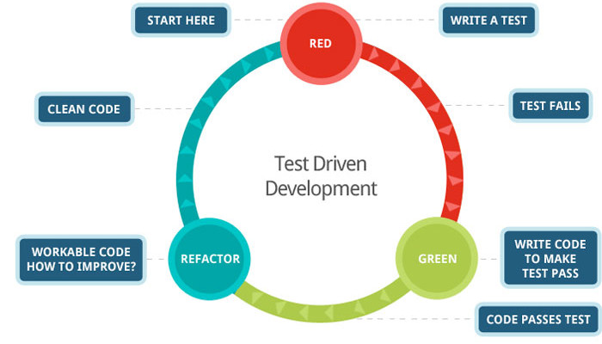
TEST DRIVEN DEVELOPMENT
TDD is the idea that, before you write any code, you write a test that acts as a specification for exactly what that code is supposed to do.

Slide 4
Ohh nooo

Slide 5
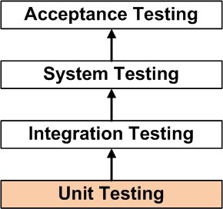
What is Unit Testing?
write tests which exercise the smallest “unit” of code possible.
Notes:
Slide Objectives:
Explain unit testing and NUnit
Speaking Points:
There are many testing frameworks.
Red Gate
JetBrains
Infragistics
Visual Studio
Microsoft

Slide 6
What Makes a Good Test?
They should all be independent and isolated
Each test should test a single item
Each test should be clear and readable
Don’t test the compiler
Use production quality
They should be reliable and repeatable
They should be valuable
Notes:
Slide Objectives:
Explain what makes a good unit test
Speaking Points:
You should able to run the tests in any order, 1-2-3 or 3-2-1, and get the same results.
It’s ok to have multiple Assert statements in a single test as long as they are related.
In a calculator tests you wouldn’t have both an additional and multiplication assertion statement.

Slide 7
What can be tested?
Valid inputs
Errors, exceptions, and events
Boundary conditions
Everything that could possibly break!

Slide 8
Traditional Testing
Test the system as a whole
Individual components rarely tested
Errors go undetected
Isolation of errors difficult to track down
Notes:
Software is made up of a number of components. Each component is used by other parts of the system to form some either the application or some major part of the end application. Traditional testing leaves the validation of the system to the end. Due to a number of reasons, the system may not operate correctly:
Poor interface/API design
Procedures/functions/methods not written correctly
Integration not correctly performed
Requirements not clearly defined
When bugs are found, or when the functionality of the system is not operating how it should, the task of tracking down exactly what goes wrong is extremely difficult. This mess can be further compounded when changes are made to the code. Since testing is performed at the highest level, there is no guarantee that the system will operate exactly as it was before because there is no guarantee that other parts of the code are going to break.
Question: How can we be certain that the system will operate correctly when we can’t guarantee that the smallest parts of the system are going to work independently? Alternatively, when putting together parts that don’t work, aren’t we going to be guaranteed that the system as whole is not going to work?
We can reduce the number of bugs in the system, but validating that each component on its own operates correctly. The traditional testing can then validate that the pieces of code all operate together.

Slide 9
Unit Testing
Each part tested individually
All components tested at least once
Errors picked up earlier
Scope is smaller, easier to fix errors
Notes:
Unit testing aims at testing each of the components that a system are built upon. As long as each of them work as they are defined to, then the system as a whole has a better chance of working together.
Where possible, all units that could possibly fail are tested at least one. Judgement is needed to decide what parts need testing. Some things such as accessors/mutators generally don’t need to be tested.
Components that are erroneous can be detected earlier. The scope of unit tests is even smaller that your traditional tests. If errors are detected, they are generally easier to fix.

Slide 10
Why Write Unit Tests?
Happier Development Team
Fewer late nights
More time actually spent on the app and not on bugs
Happier Users
Fewer defects and bugs reaching production
Reliability
Exact same test code runs each time
No variance caused by human error
Faster Execution
Quicker than a human performing tests manually
Effective unit testing is one of the biggest contributors to high quality software
Notes:
Slide Objectives:
Explain why writing tests are good for you
Speaking Points:

Slide 11
Why Write Unit Tests? (Cont $$$)
Reduced Business Cost
Defects are found earlier in the project lifecycle
A 2003 study commissioned by the Department of Commerce’s National Institute of Standard and Technology found that software bugs cost the US economy $5.5 billion annually
The cost of the bug depends on when it is found
Per the System Sciences Institute at IBM “the cost to fix an error after production release was four to five times as much as one uncovered during design.”
If a bug found in the gather phase cost $100 then it is estimated it would cost $1,500 in the QA phase and $10,000 if found in production.
Notes:
Slide Objectives:
Continue explaining why writing tests are good for you
Speaking Points:
Mariner 1 (1962) spacecraft was destroyed 289 seconds after takeoff due to a missed overbar, hyphen, in the guidance code.
This bug was present in the two previous Ranger missions but not found until the Mariner 1 due to hardware malfunctions of a guidance antenna.
It cost $18.5M in 1962, $145M in 2014.

Slide 12
Unit Testing
In Isolation
Automatic
Replace Dependencies…
…with Mocks
Unit Testing Framework
Continuous Integration
Dependency Injection Framework
Mock Library
nUnit
mbUnit
xUnit.Net
VS TestTools
CrouiseControl.Net VS Team System
nMock EasyMock Rhino.Mocks TypeMock
By hand
Spring.Net Castle/Windsor Unity StructureMap

Slide 13
Class Under Test May Call Many Others
In a unit test we want to test just one class, not the whole calling graph
ClassUnderTest
Dependency1
Dependency2
Dependency3
ClassA
ClassB
ClassC
ClassD
ClassE
F
G
H
I
J
K
L
M
N
Database
Network
File System
Printer
Nuclear Rocket Launcher

Slide 14
Replace Dependencies with Mocks
This reduces amount of code under test to just one class
ClassUnderTest
Dependency1
Mock
Dependency2
Mock
Dependency3
Mock

Slide 15
Ejemplo en C#

Slide 16
How to Designate a Test?
Optional with v2.5
[TestFixture]
Public class CalculatorTests
{
[Test]
public void ShouldAddTwoNumbers()
{
var sut = new Calculator();
// System Under Test
// Test code here
}
}
Notes:
Slide Objectives:
Display the formatting to create a test
Speaking Points:
Why TestFixture and not TestClass?
NUnit 1.0 was a direct port from JUnit and it was called TestFixture there.
Come up with some general guidelines to be followed throughout the code. This will help transitioning the code around as well creating some standards.
Classes end with ‘Tests’
Methods begin with ‘Should’
Instances should be assigned to a commonly named variable

Slide 17
What are Asserts?
[Test]
public void ShouldAddTwoNumbers()
{
Assert.That(Calculator.Add(1,2), Is.EqualTo(3));
// Older style Nunit asserts
Assert.AreEqual(3, Calculator.Add(1,2));
}
actual
expected
Notes:
Slide Objectives:
Display the formatting to create a test
Speaking Points:

Slide 18


Getting started with TDD
Get some training
Start with a small visible project
Shoot for 100% test coverage
Don’t expect to be perfect
Expect to improve dramatically in time
Measure the results

Slide 19
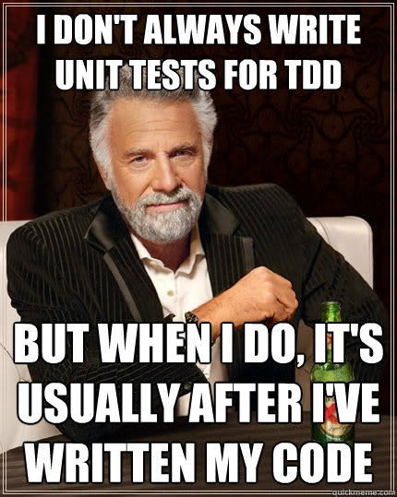

Slide 20
TDD in Legacy Code
Go Hunting for Bear
Got Bugs?
Go after your most painful defect
Success
TDD is a skill
Build the Safety Net
Work in small increments
Expect to slow down, then speed up
Measure the results
Write a test to expose it
Write code needed to fix it
Refactor
Repeat
Measure the results
Just Do It
Insist on achieving 100% coverage
Measure and Review
Make Results Visible
Just Keep Doing It

Slide 21
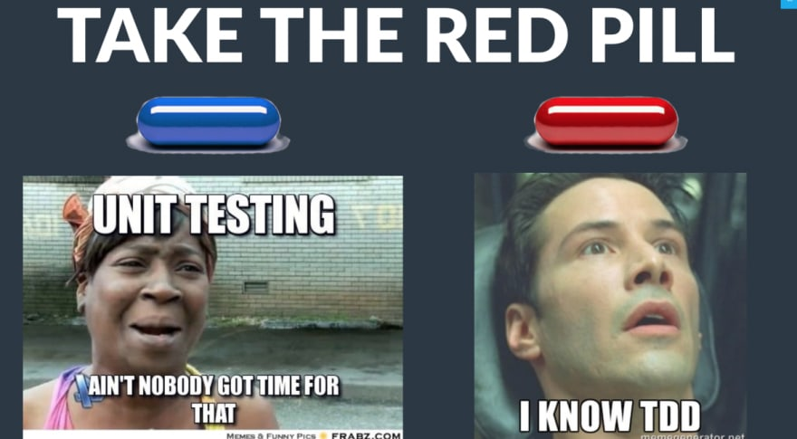

Slide 22

Julissa mateo abad
Gerente ti and ecm Bunker, lead mujeresticsrd
/ Julissammateo@gmail.com
Julissamateo@mujeresticsrd.org
@mateojulissa or @mujeresticsrd

Slide 23

Julissa mateo abad
Gerente ti and ecm Bunker, lead mujeresticsrd
/ Julissammateo@gmail.com
Julissamateo@mujeresticsrd.org
@mateojulissa or @mujeresticsrd

